Slide 1
INTRODUCTION TO ENVIRONMENTAL STUDIES
CEN-105
Civil + Chemical Faculty members
Dr. Basheshwer Prasad
Department of Chemical Engineering
bashefch@iitr.ac.in

Slide 2
CEN-105: Introduction to Environmental Studies Credits: 3; L: 3; Marks: CWS=25 (10+5+10), MTE=25, ETE=50
S. No. | Contents
1. | Overview
2. | Renewable energy
3. | Water –Soil Interaction
4. | Water treatment and wastewater treatment
5. | Air resources, ozone depletion, global warming, climate change
6. | Land pollution and solid waste management, Wetlands
7. | Ecosystem, ecological relationships and policy
8. | Hazardous wastes

Slide 3
CEN-105 Introduction to Environmental Studies
Objective: To introduce fundamentals of environmental pollution and its control
S. No. | Name of Books / Authors/ Publishers | Year of Publication/
1 | Davis M. L. and Cornwell D. A., “Introduction to Environmental Engineering”, McGraw Hill, New York 4/e | 2008
2 | Masters G. M., “Introduction to Environmental Engineering and Science”, Prentice Hall of India, New Delhi. 2/e | 2007
3 | Peavy H. S., Rowe D.R. and Tchobanoglous G., “Environmental Engineering”, McGraw Hill, New York | 1986
4. | Mines R.O. and Lackey L.W. “Introduction to Environmental Engineering”, Prentice Hall, New York | 2009
5. | Mihelcic J. R. and Zimmerman J.B. “ Environmental Engineering; Fundamentals, Sustainability, Design” John Wiley and Sons, Inc | 2010

Slide 4
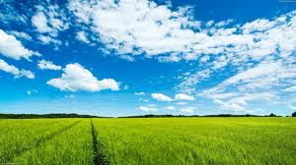
Why take this course?
Why study about the environment?
Common to all branches of engineering

Slide 5
The Supreme Court of India has ordered that every student at college/university/institute level be exposed to a course on environment
It is not only to create an awareness of environmental issues, but also to bring about pro-environmental action

Slide 6
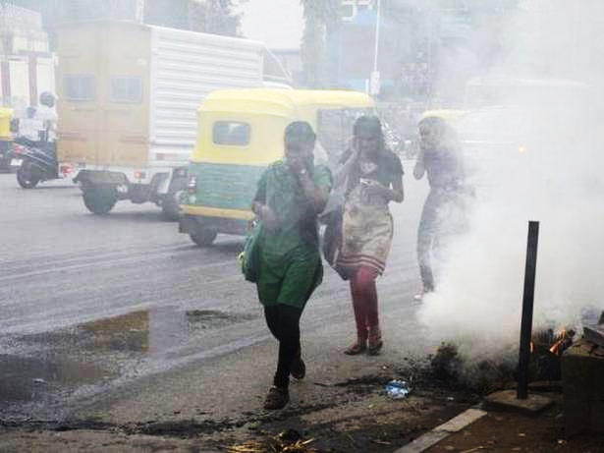
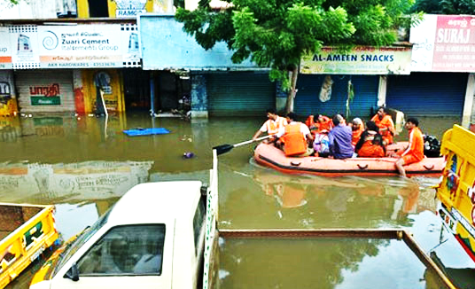
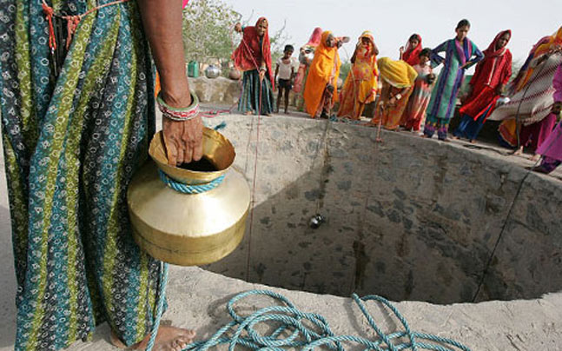
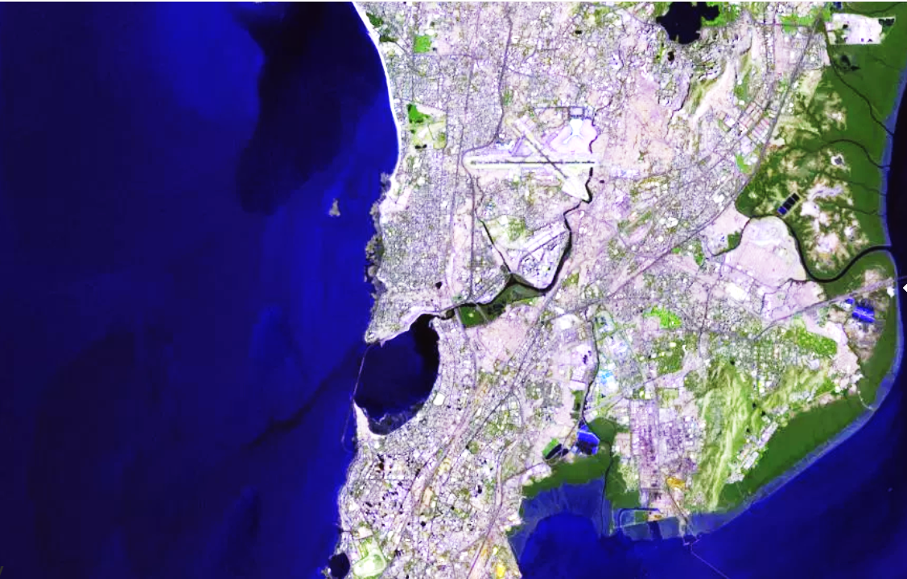
Major environmental issues in India
1. Pollution and public health burden
2. Extreme weather events & climate change
3. Resource depletion
4. Unsustainable growth

Slide 7
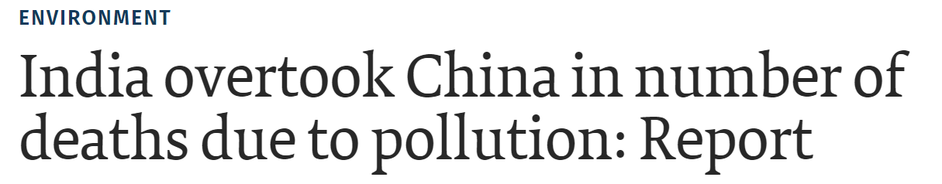
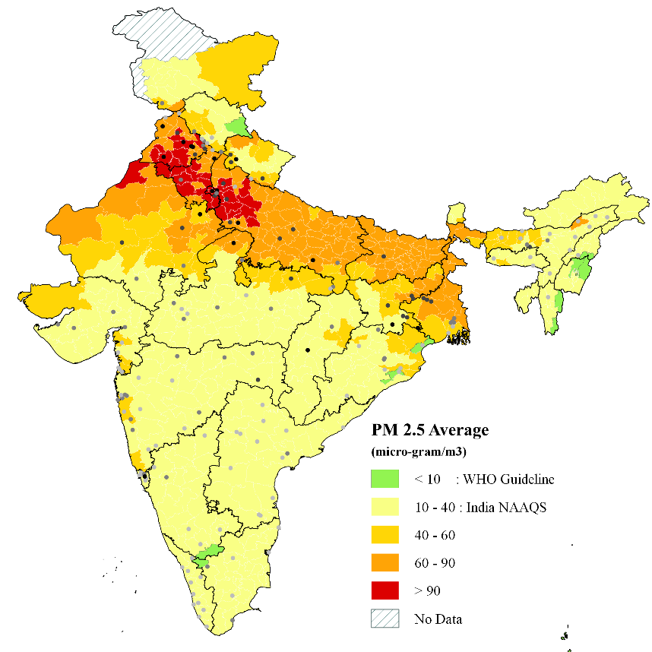
1. Pollution and public health burden
Institute for Health Metrics and Evaluation at the University of Washington in Seattle found that India had 3,283 premature deaths due to ambient air pollution every day (China: 3,233 per day)
Reduced life expectancy by 3.2 years on average

Slide 8
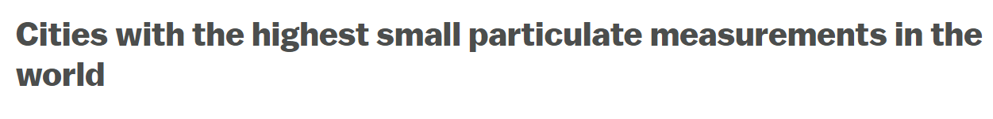
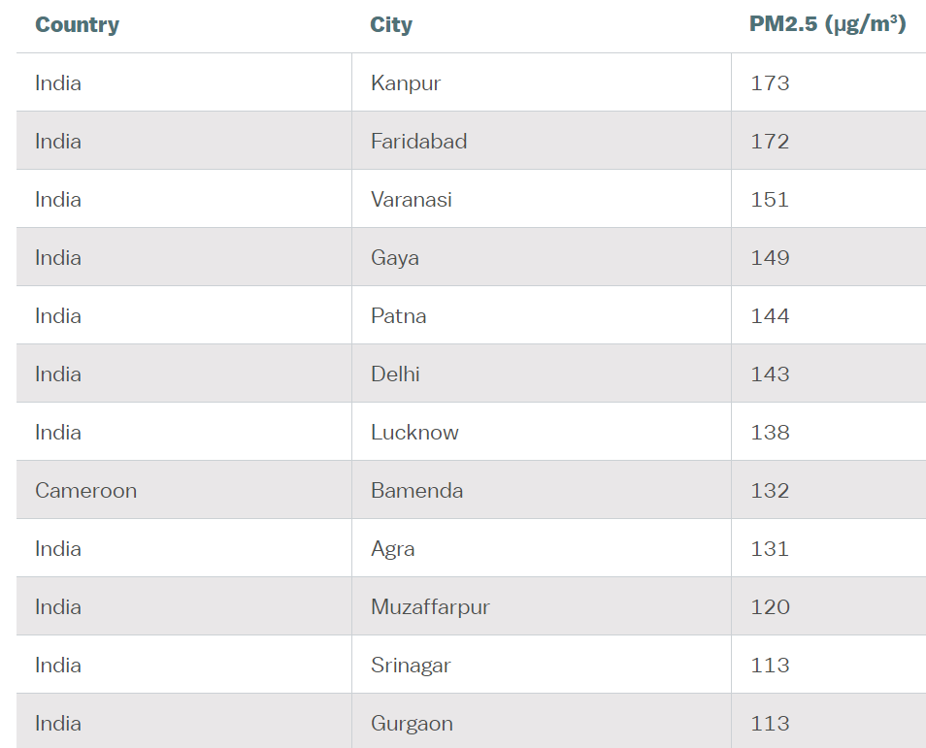
1. Pollution and public health burden
SPM, PM, PM10, PM2.5, PM1.5
11 out of 12 top cities are Indian
WHO, 2016

Slide 9
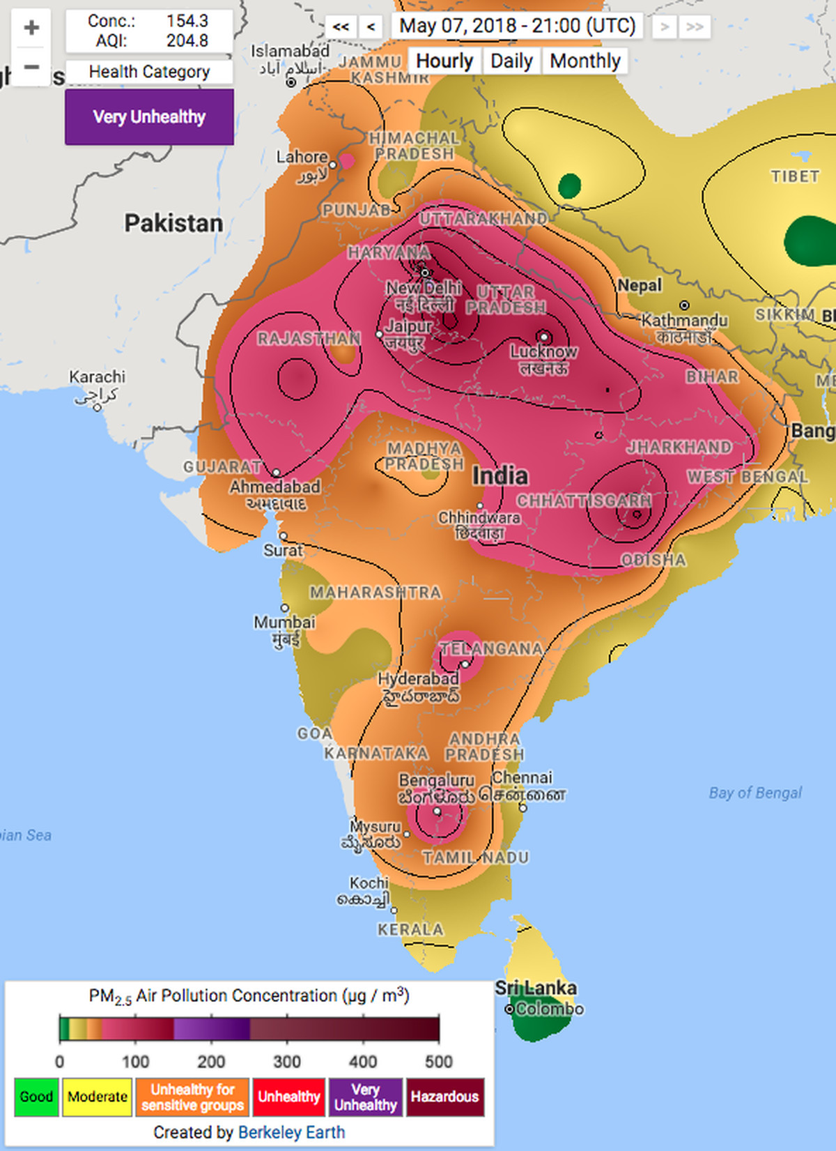
Anthropogenic damage
For the first time humanity is facing the real possibility of an unsuitable earth to live in
Air Quality Index
WHO, 2016

Slide 10
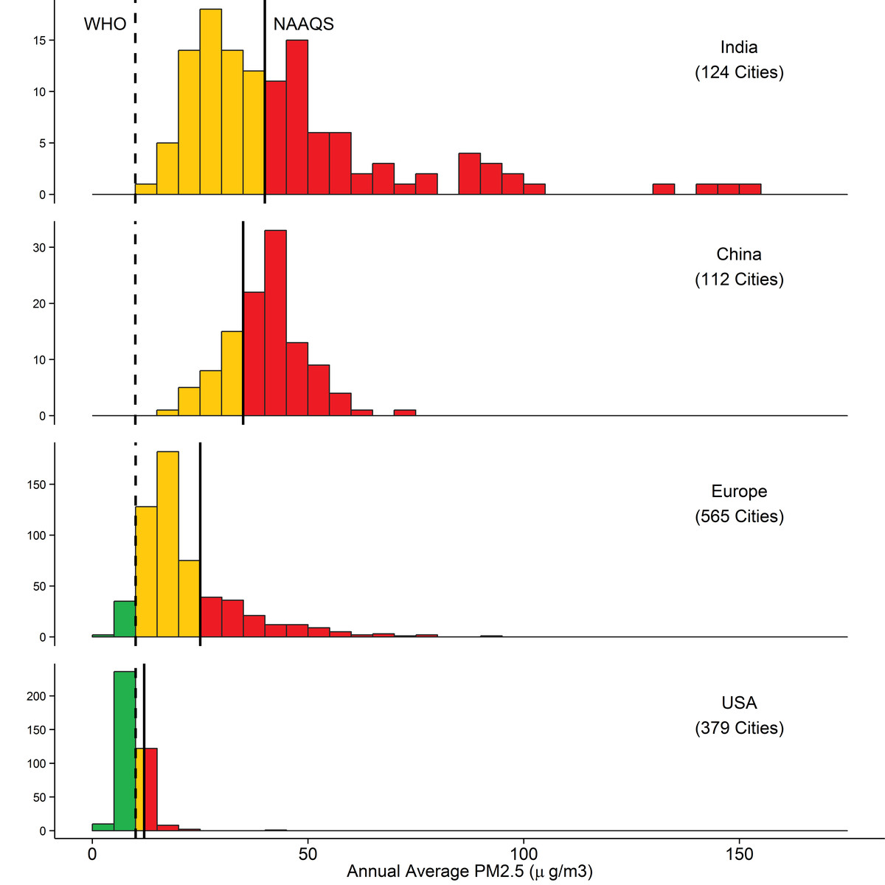
Air Quality Scenario
National Ambient Air Quality Standards (NAAQS)
WHO PM2.5 standard
10 μg/m³ annual mean 25 μg/m³ 24-hour mean
India PM2.5 standard
40 μg/m³ annual mean 60 μg/m³ 24-hour mean

Slide 11
DEVELOPMENT & SUSTAINABILITY
Major Causes for Indian air woes
Anthropogenic emissions:
Combustion: Coal, Diesel, Petrol, CNG, Biomass; Industries- Chemical in particular
Policies and governance:
BS: VI 2020, Trains/ metro, population
Geography:
Valley vs plain area
Meteorology:
Wind velocity, temperature, rain fall

Slide 12
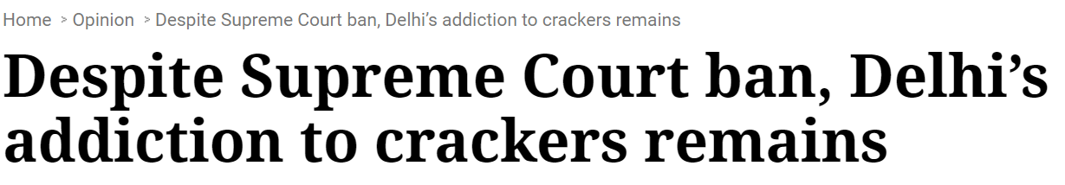
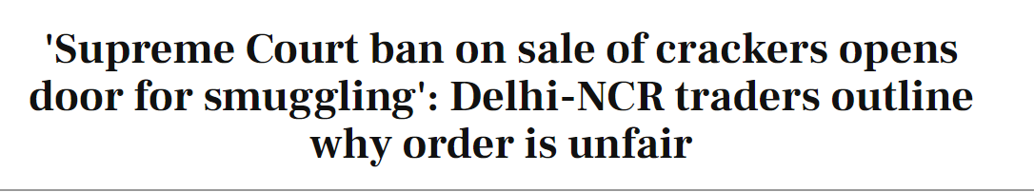

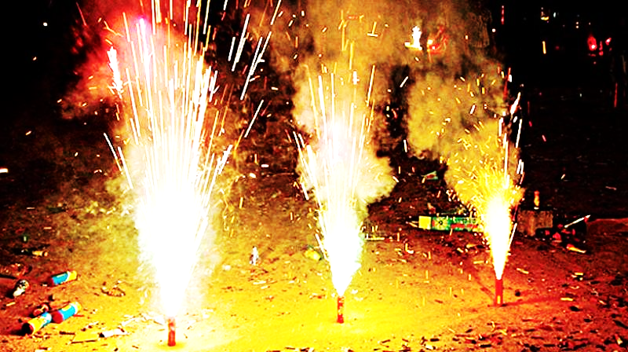
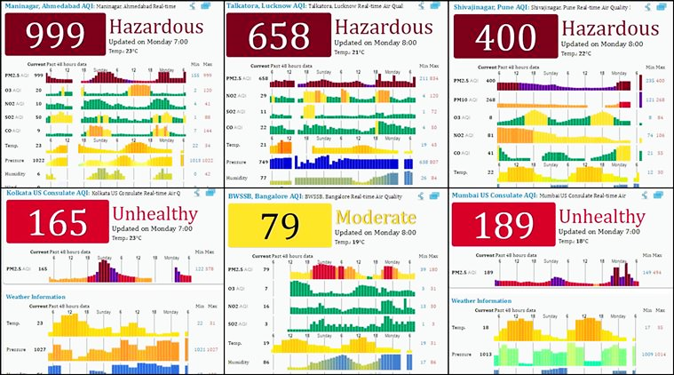
Anthropogenic damage due to lack of awareness
Post Diwali, 2018

Slide 13
Electronic Waste: An example
More than 20 million computers are thrown out every year world wide, very few are recycled.
More than 200 million computers shall be obsolete world wide within a next few years.
Same is true for many other electronic goods. For example, cell phones, fridges, microwave ovens, CFL, tube lights, LED lights etc.

Slide 14
Problems with Electronic Industry
Designers are not responsible for end of life design
Product manufacturing does not consider the entire life time of the product
Result is waste – economically inefficient, environmentally harmful, socially irresponsible
UNSUSTAINABLE
What to do with such a huge amount of e-waste?

Slide 15
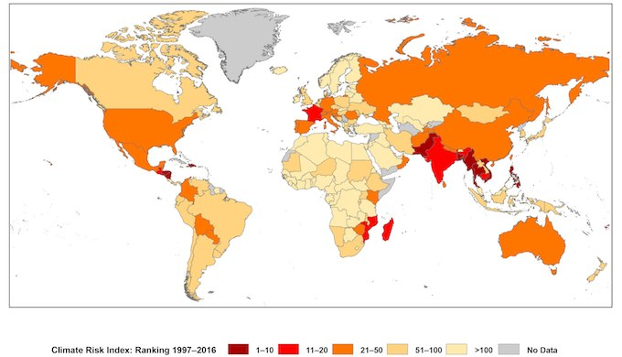
2. Climate change
World map of the Global Climate Risk Index for 1997–2016
[Germanwatch & Munich Re NatCatService]

Slide 17
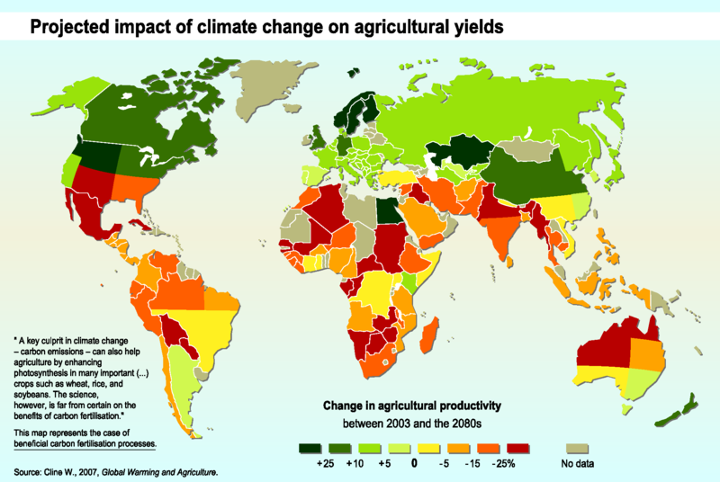
2. Climate change

Slide 18
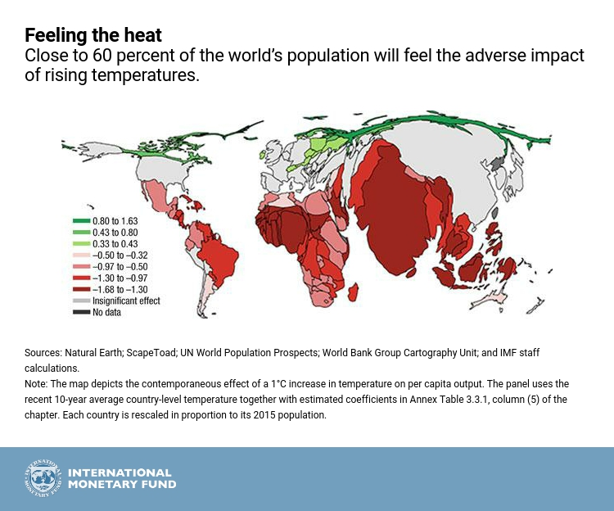

Slide 19
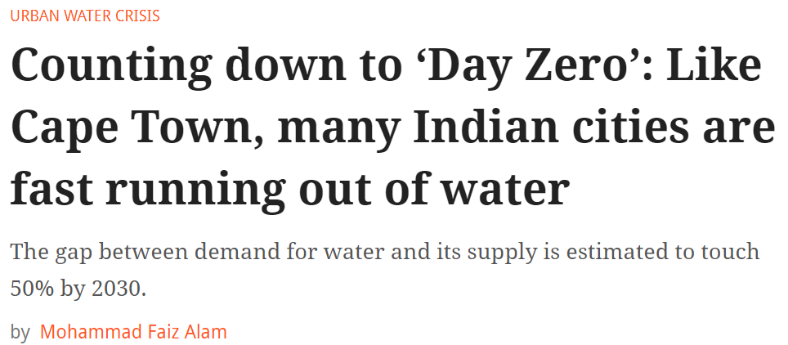
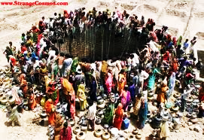
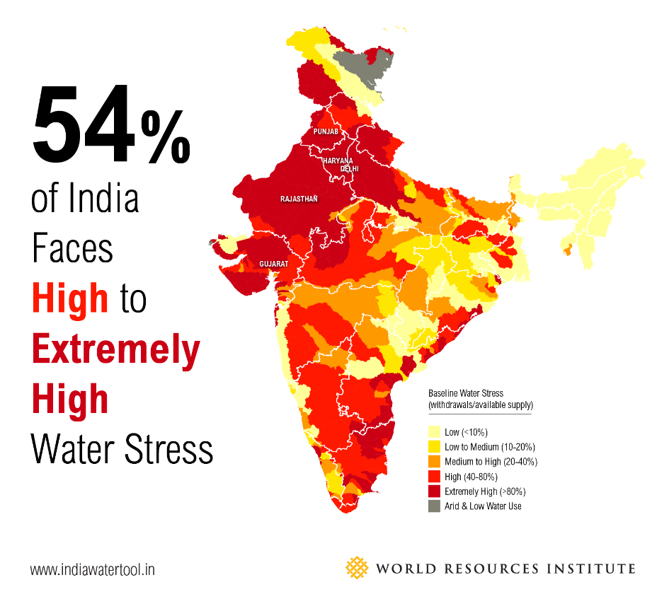
3. Resource depletion
Groundwater depletion
Need public awareness to drive implementation of reforms
The ground water is depleting
Less rains
No recharging of ground water

Slide 20
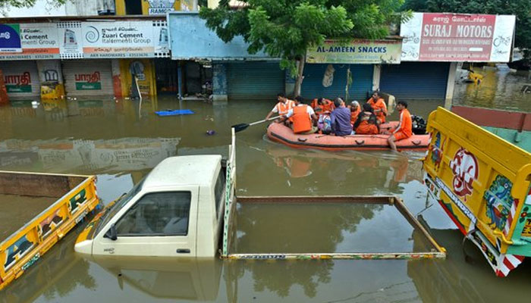
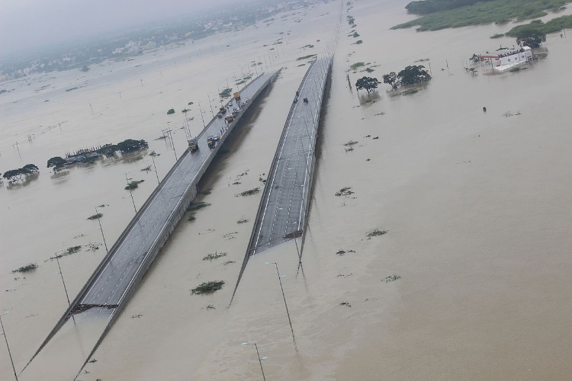
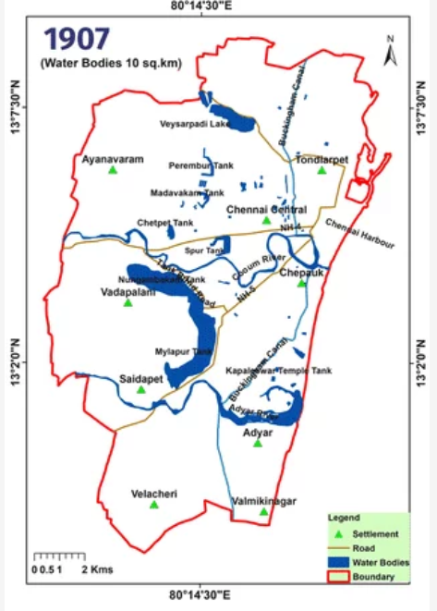
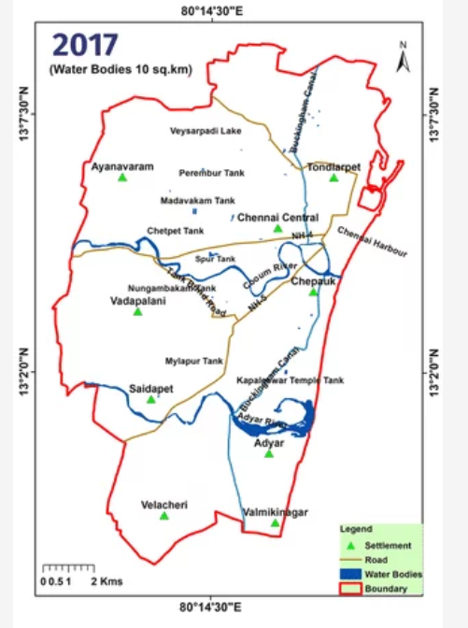
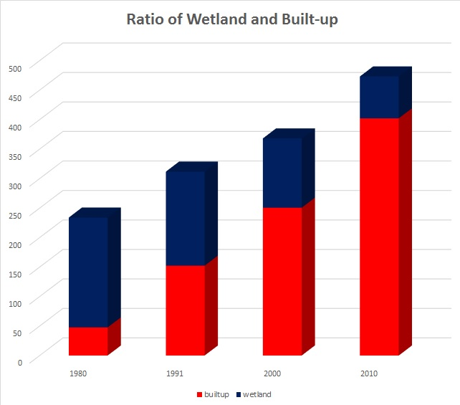
4. Unsustainable growth
(Annual) Chennai floods
More than 150 wetlands were encroached in last 25 years
Built up area
Wetland

Slide 21
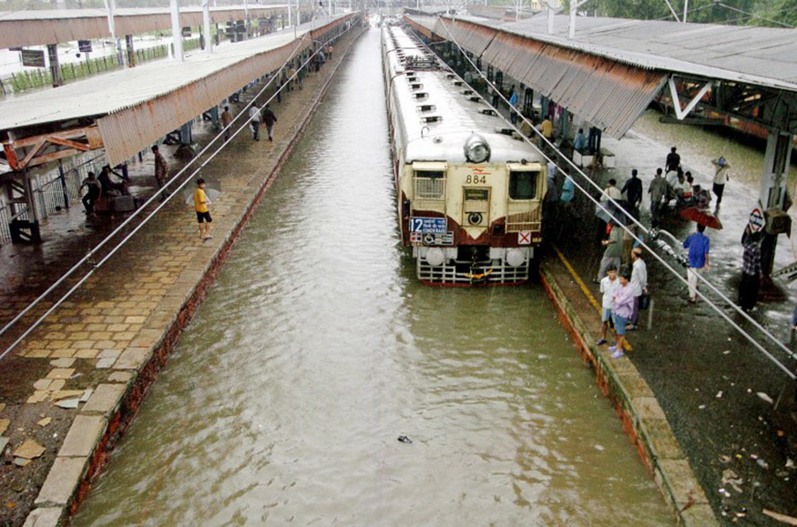
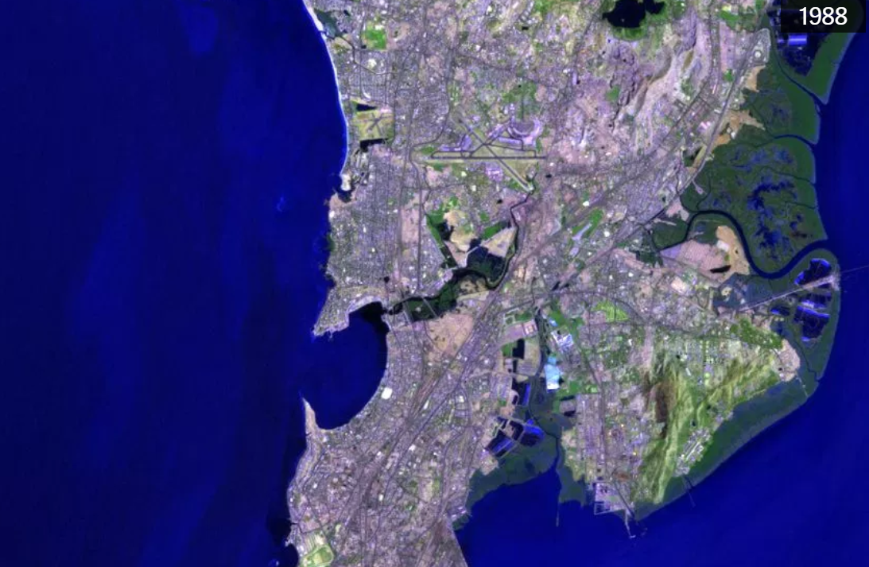
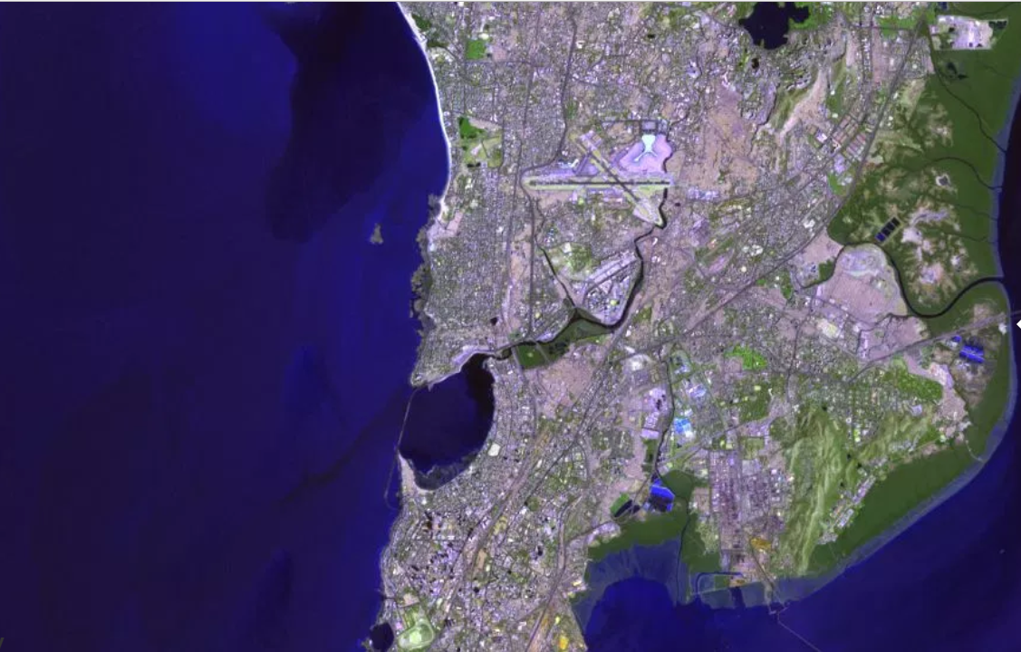
Mumbai floods
Rapid concretization
Indiscriminate felling of mangrove forests for estate and salt pans development
More than 1,000 dead in 2005 floods
1988
2017
Notes:
Mumbai is essentially a peninsula jutting into the Arabian Sea. Since the 1980s, when a little over eight million called it home, the city’s population has more than doubled. That’s led to rapid urbanisation of the surrounding areas, as well as encroachment of the mangroves on the city’s edges.
…Mumbai’s major nullahs form a vein-like network that can extend for an astounding 300 km. These could have functioned effectively to drain water out of the city. But this is a natural legacy that the city authorities have abused, with the reckless sanctioning of building after building, in brazen collusion with builders and venal bureaucrats. By indiscriminately dumping waste in open drains, citizens have also contributed to choking them.

Slide 22
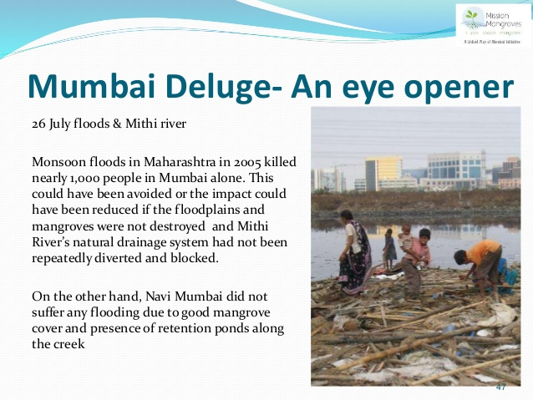
Dr. V. Shubhalaxmi
iNaturewatch Foundation

Slide 23
Development has to be sustainable!!

Slide 24
SUSTAINABLE DEVELOPMENT
Agreed Definition:
Brundtland’s definition: “…meeting the needs of the present without compromising the ability of future generations to meet their own needs.”

Slide 25
DEVELOPMENT & ITS UNINTENDED CONSEQUENCES
What is Development?
Resource utilization to provide facilities and services
India is very rich in resources: Land, coal, ores, crude petroleum and most importantly human resource
Unintended Consequences
Resource depletion: Human resource-no depletion
Pollution/Environmental degradation
What are we giving back to surrounding?
Air: Polluted
Water: Polluted / contaminated
Wastes: Solid-to pile up, liquid to pollute water

Slide 26
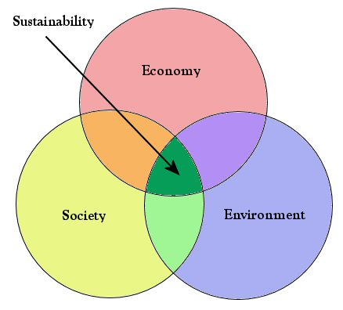
WILL WE DEVELOP A SUSTAINABLE WAY?
The triple bottom line: sustainable solutions that meet
Environmental goals- Air, Water, Soil
Economic goals-Punjab Agriculture*
Social goals- Health, House, Car, Cancer
Requires that humans apply knowledge
from the sciences to
Limit environmental impacts
Maintain functioning of ecological systems
*Chemical fertilizers, insecticides, pesticides, herbicides,
All out, Body spray
Organic farming-Compost

Slide 27
Sustainable Development
How does environment respond to development? Drinking water supply, liquid waste disposal
Ganga, Yamuna and other rivers being contaminated
How can development be made environment friendly? Green Buildings, Run off the river hydro plant
Answer is Sustainable Development

Slide 28
Environment
Biotic & Abiotic Components
Interactions/Processes
Air-water
Air-Soil
Soil-Water
Air-Water-Soil
Interaction of life with air, water, soil
Structural & Functional Components of the Ecosystem
Natural System connects and supports all life on Earth by providing
Oxygen, Water, Food
Services
Elemental and chemical composition of the earth together with energy from the sun, constitutes all of the raw material that support life.
Atmosphere;
Gas Phase
air
life
Biosphere
water
land
Hydrosphere
Aqueous Phase
Lithosphere
Solid Phase

Slide 29
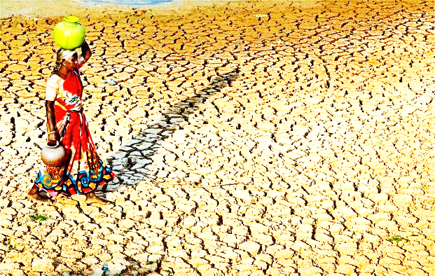
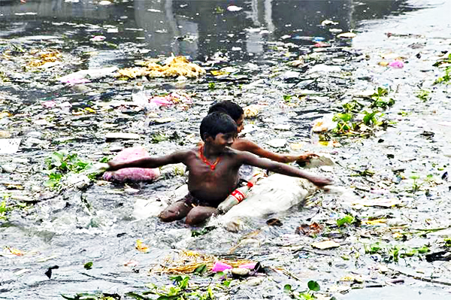
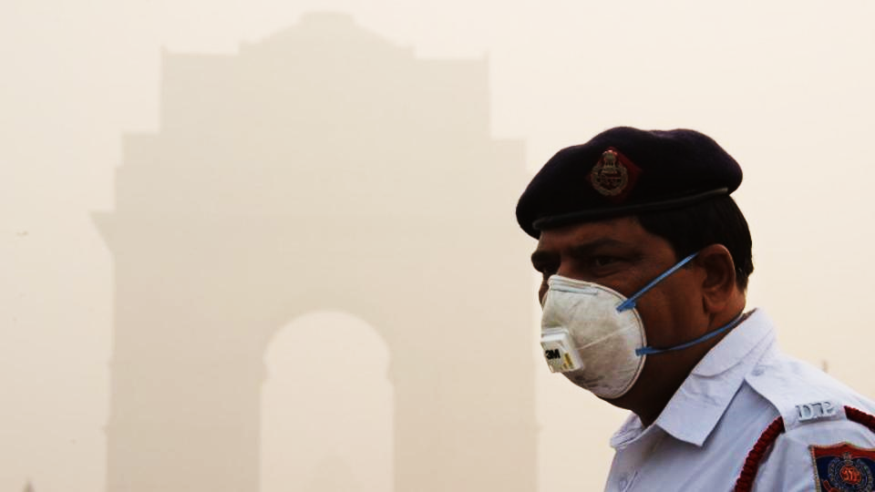
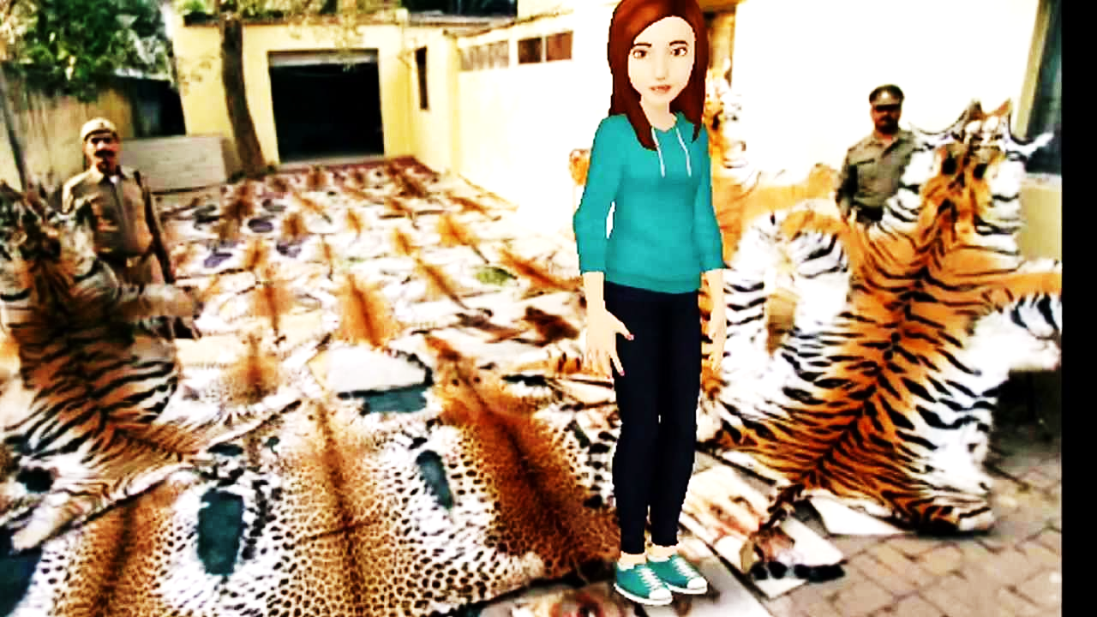
What is the use of a house if you haven’t got a tolerable planet to put it on?
Henry D. Thoreau

Slide 30
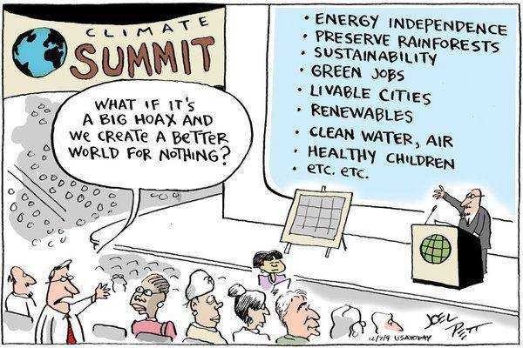

Slide 31
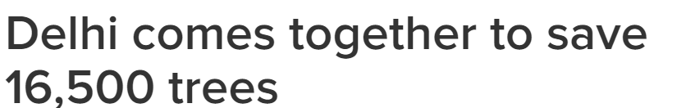
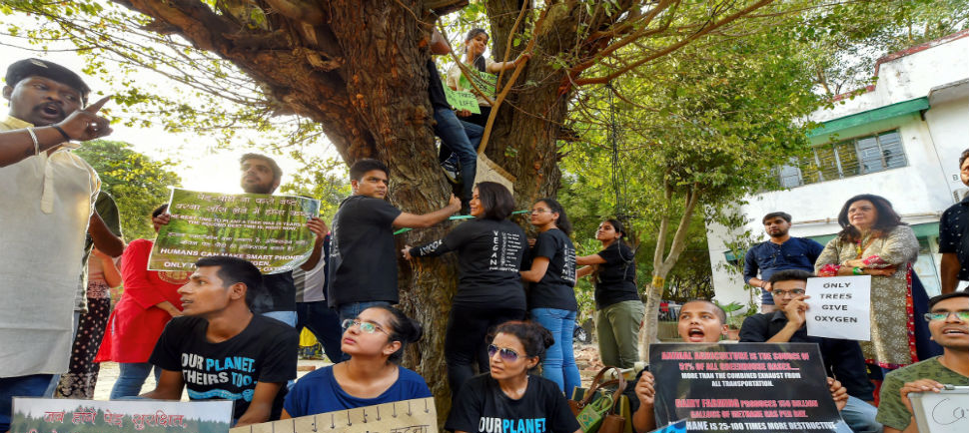
A recent example of environmental
pro-activeness
June 25th, 2018
Delhi High Court has questioned if the city can afford trees being cut for the sake of roads and buildings after citizen’s protest
Delhi’s own Chipko movement led to High Court stay on felling of trees for building residences for officials and roads

Slide 32
Existing & Emerging Environmental Issues Source: United Nations Environment Programme, 2016
According to ‘UNEP Frontiers 2016 Report: Emerging Issues of Environmental Concern,’
the rise in zoonotic diseases (diseases that can spread between animals and humans, and which include Ebola, bird flu and the Zika virus);
increasing crop toxicity due to climate change;
microplastic waste in oceans and its effects on human health;
the potential role of the world’s financial sector in advancing sustainable development and a low-carbon, resource efficient future;
illegal trade in live animals, including disease transmission;
and loss and damage, and negative impacts of climate change on ecosystems.

Slide 33
Environmental Systems (Natural and Engineered)
Natural Systems: Very difficult to model & predict, rain forecast?
Pollutants in air, water?
Concern is with understanding and describing changes in constituent concentrations and other quality parameters;
Measure given conditions and describe
anticipated changes in constituent(s)
(Output depends on prevailing conditions)
Engineered System: Easier to model & predict, IC engine?
Concern is with the selection of conditions required to effectively accomplish specific changes in concentration
and quality parameters
Determine desired changes in constituent
and prescribe required conditions
(Conditions are modified to get desired output-
Experimental verification possible)
Describe
Design

Slide 34
Environmental Processes
Environmental processes of interest are of two categories:
Transformation Processes- Changes
Environment is comprised of chemicals & transformation in them are described by reactions
Reactions are physical, chemical and/or biological in nature.
Three dominant characteristics of environmental processes are:
The form and amount of energy available to make them occur
The rate at which energy is used to effect change. Most of the environmental reactions follow fist order kinetics
A system of such spatial and physical characteristics that it allows reactants to interact or “communicate” for purposes of reactions.
2. Transport Processes- Movements
Macroscale Transport (System Scale):
Movement of constituents in the bulk of a system & across its boundaries
Example: Waste liquid stream (Nalaha) getting into a river
Microscale Transport (Molecular Scale):
Small scale diffusion processes
Occur primarily at the interfaces
Transport from one phase to another is referred to as mass transfer
Example: Spillage of Petrol/Diesel

Slide 35
Environmental Systems (Measurement of Quantity and Concentration)
Extensive Properties:
Magnitude depends on the size of the system or on sample taken from the system (e.g. mass, volume and heat capacity).
Quantity is an extensive property
Intensive property:
Magnitude does not depend on the size of a system or on sample taken from it (e.g. temperature, density, specific heat etc.)
Concentration is an intensive property
Expression of concentration:
mass fraction (0-1; % (per cent,100); ‰ (per mil,1000); ppm; ppb; ppt)
volume fraction, mole fraction, mass per unit volume, moles per unit volume (molar), moles per unit mass (molal), equivalents (normal)
Partial Pressure: Species amount in air may be expressed as partial pressure

Slide 36
Environmental Units
Units used in environmental studies vary from MLD to l/s, from kilometre to mm, and from Mega tonnes to μg
Parts per million (ppm) or parts per billion (ppb) or parts per trillion (ppt) are another popular ratio based unit used in environmental studies. Note that depending upon the matrix, the convention of representing the ratio as follows:
Solid | mass/mass | To convert into mass/volume use sp. gravity of matrix
Liquid | mass/volume | To convert into mass/volume use sp. gravity of matrix
Gas | volume/volume | To convert into mass/volume use ideal gas law

Slide 37
Environmental measurement
1. Ten gram of table salt (NaCl) in pure water is dissolved to make 1 L of solution. Determine for Na⁺ : the mass fraction (%, ppm), mass concentration, molarity, molality, normality, mole fraction in the solution. (Na = 23; Cl = 35.5)
Molecular weight of NaCl = 23 + 35.5 = 58.5
10 g NaCl = 10/58.5 = 0.17 mole; Na⁺= 0.17 mole x 23 g/mole = 3.91 g of Na⁺.
Mass fraction = 3.9/10 =0.39 % = 0.0039*10⁶ = 3900 ppm
Mass concentration = 3.9 g/L = 3900 mg/L ( in aq. systems, mg/L = ppm)
Molarity =0.17 mole/L or 0.17 M; Normality = 0.17 eq/L = 0.17 N
Molality = 0.17 mole/ 0.99 kg = 0.172
Mole fraction = 0.17/ (0.17 + (990/18) = 3.08 x 10⁻³
Mole fraction of aqueous glucose solution is 0.025. What is the molar & mass concentration of glucose? (Assumption: specific density of the solution = 1)
Moles of glucose = 0.025 = 0.25 x 180 = 4.5 g
& moles of water = 0.975 = 0.75 x 18 = 17.55 g
molar concentration = (.025/ 17.55) x 1000 = 1.42 M
mass concentration = (4.5 g/17.55) x 1000 = 256.4 g/L

Slide 38
Environmental Units
Q1. Concentration of Uranium in historically contaminated soil is 100 μg/L. How much Uranium is present in 1 g of soil? The sp. gravity of soil is 2.60.
Sol. 100 μg of U in 1L of soil
i.e., 100 μg of U in 1L x 1000 g/1L x 2.60 =2600 g of soil
i.e., 0.0385 μg of U in 1 g of soil

Slide 39
Environmental Units
Q2. The ambient concentration of CO₂ in a city is 400 ppm (v/v) on a particular day. Express its concentration as mg/L (ppm in m/v)of air. Assume STP.
Sol. 400 x 10⁻⁶ L of CO₂ in 1 L of air (def. of ppm)
Mass of 400 of CO₂ can be calculated using the ideal gas law: PV = nRT
1 atm x 400 x 10⁻⁶ L = n(0.082 Latm/mol.K) x 273.15 K
n = 17.86 x 10⁻⁶ moles
Weight of CO₂ in 1 L of air = 17.86 x 10⁻⁶ x 44 g = 785.84 μg = 0.785 mg
Concentration of CO₂ in atmosphere = 0.785 g/L

Slide 40
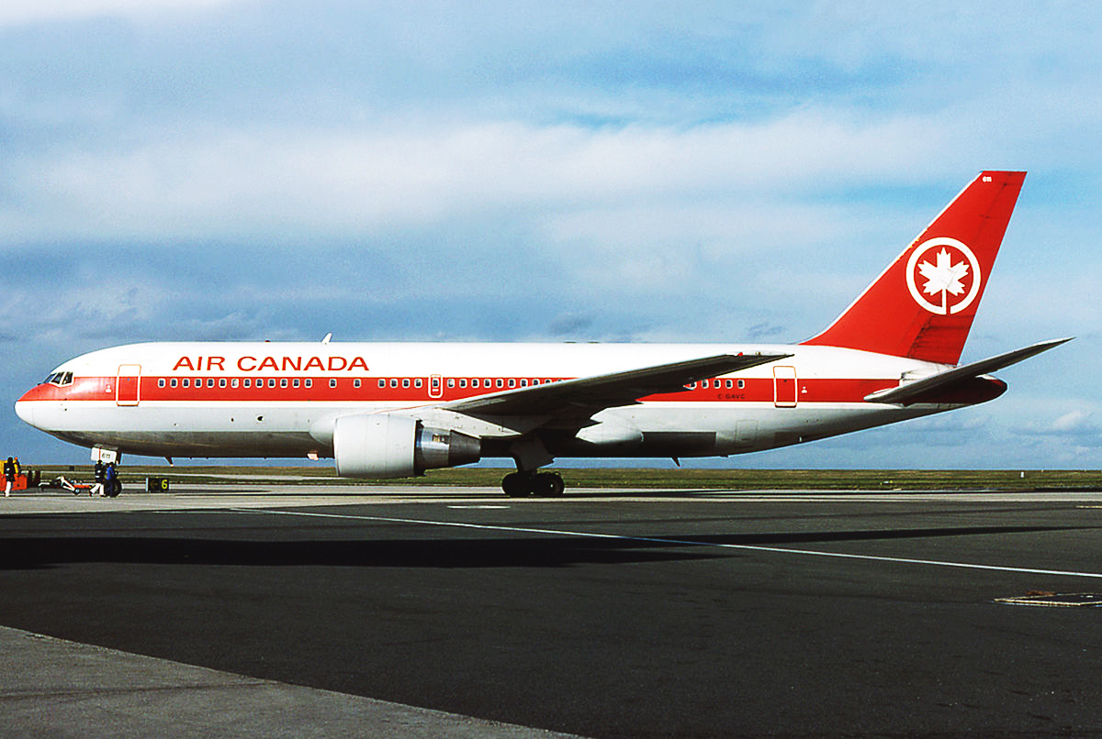
Environmental Units
Units are simple but very important to get right
Air Canada flight 143 Boeing 767 (Gimli Glider,1983)
The ground crew filled the tanks according to their records. The fuel requirements were assumed to be in litres but they had been recorded in gallons. Midway through the flight it ran out of fuel!
Another unit error!

Slide 41

Environmental Units
Units are simple but very important to get right
NASA Mars Climate Orbiter
NASA lost a $125 million Mars orbiter because a Lockheed Martin engineering team used English units of measurement while the agency's team used the more conventional metric system for a key spacecraft operation

Slide 42
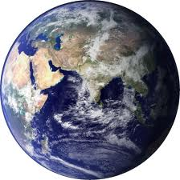
The Earth is finite……..
So are the natural resources……..
We need to preserve them……….

